Slide 1
Version 2.00
UCSD CSE 30
Computer Organization and Systems Programming
Numbers Data and Memory
Cao Session. Slides Credit Keith Muller
Cray XMP-1982

Slide 2
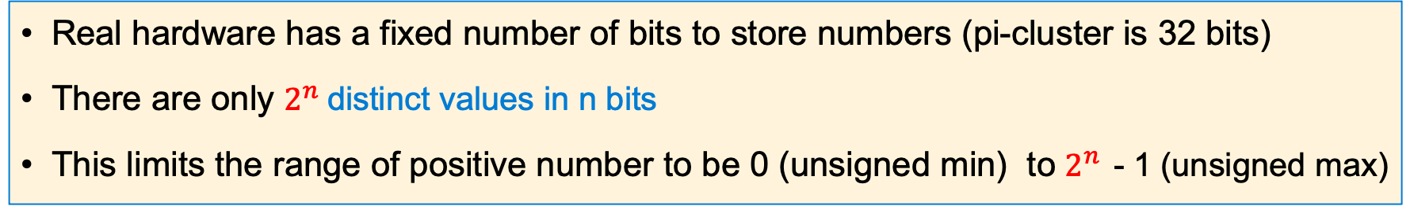
Positive Number (unsigned) in 4 bits
Real hardware has a fixed number of bits to store numbers (pi-cluster is 32 bits)
There are only $2^{n}$distinct values in n bits
This limits the range of positive number to be 0 (unsigned min) to $2^{n }$- 1 (unsigned max)
Hex digit | 0x0 | 0x1 | 0x2 | 0x3 | 0x4 | 0x5 | 0x6 | 0x7
Decimal value | 0 | 1 | 2 | 3 | 4 | 5 | 6 | 7
Binary value | 0b0000 | 0b0001 | 0b0010 | 0b0011 | 0b0100 | 0b0101 | 0b0110 | 0b0111
umin
Hex digit | 0x8 | 0x9 | 0xa | 0xb | 0xc | 0xd | 0xe | 0xf
Decimal value | 8 | 9 | 10 | 11 | 12 | 13 | 14 | 15
Binary value | 0b1000 | 0b1001 | 0b1010 | 0b1011 | 0b1100 | 0b1101 | 0b1110 | 0b1111
umax
x

Slide 3
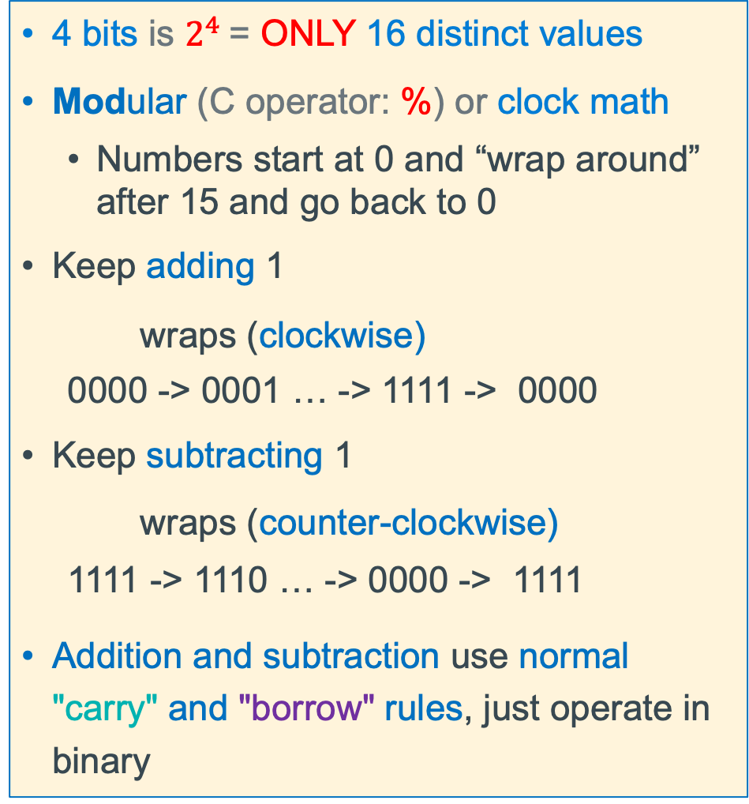
Unsigned Integers (positive numbers) with Fixed # of Bits
4 bits is $2^{4}$= ONLY 16 distinct values
Modular (C operator: %) or clock math
Numbers start at 0 and “wrap around” after 15 and go back to 0
Keep adding 1
wraps (clockwise)
0000 -> 0001 … -> 1111 -> 0000
Keep subtracting 1
wraps (counter-clockwise)
1111 -> 1110 … -> 0000 -> 1111
Addition and subtraction use normal "carry" and "borrow" rules, just operate in binary
x

Slide 4
Unsigned Binary Number: Addition in 4 bits
Be Aware in Binary
1 + 1 = 10 base 10: (1 + 1 = 2)
1 + 1 + 1 = 11 base10: (1 + 1 + 1 = 3)
Carry Bit
carries
0
1
1
1
0 0 0 1
1
+
0 1 1 1
7
sum
1
0
0
0
=
8
x

Slide 5
Unsigned Binary Number: Subtraction in 4 bits
Be Aware in Binary
1 - 1 = 0 base 10: (1 - 1 = 0)
10 - 1 = 1 base10: (2 – 1 = 1)
Borrows
1
0 1 0 1
5
-
-
0 0 1 1
3
sum
0
0
1
0
2
=
x

Slide 6
Unsigned Binary Number: Addition in 4 bits – Overflow!
Be Aware in Binary
1 + 1 = 10 base 10: (1 + 1 = 2)
1 + 1 + 1 = 11 base10: (1 + 1 + 1 = 3)
Carry Bit
carries
1
1
1
1 0 1 0
10
+
0 1 1 1
7
0
0
0
1
17
sum
=
x

Slide 7
Unsigned Binary Number: Subtraction in 4 bits – Overflow!
Be Aware in Binary
1 - 1 = 0 base 10: (1 - 1 = 0)
10 - 1 = 1 base10: (2 – 1 = 1)
Borrows
1
1
1
0
1
0 1 0 1
5
-
0 1 1 1
7
-
sum
1
1
1
0
=
2
x

Slide 8
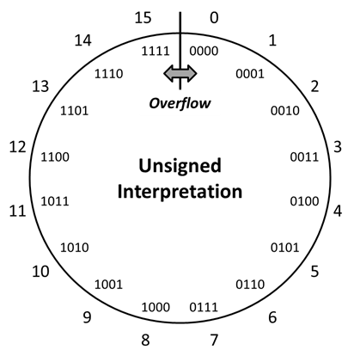
Overflow: Going Past the Boundary Between umax and umin
umax
umin
Overflow with unsigned numbers: Occurs when an arithmetic result (from addition or subtraction for example) is is more than min or max limits
Example shown is for a 4-bit number
C (and Java) ignore overflow exceptions
You end up with a bad value in your program and absolutely no warning or indication… happy debugging!….
x

Slide 9



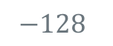
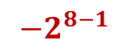
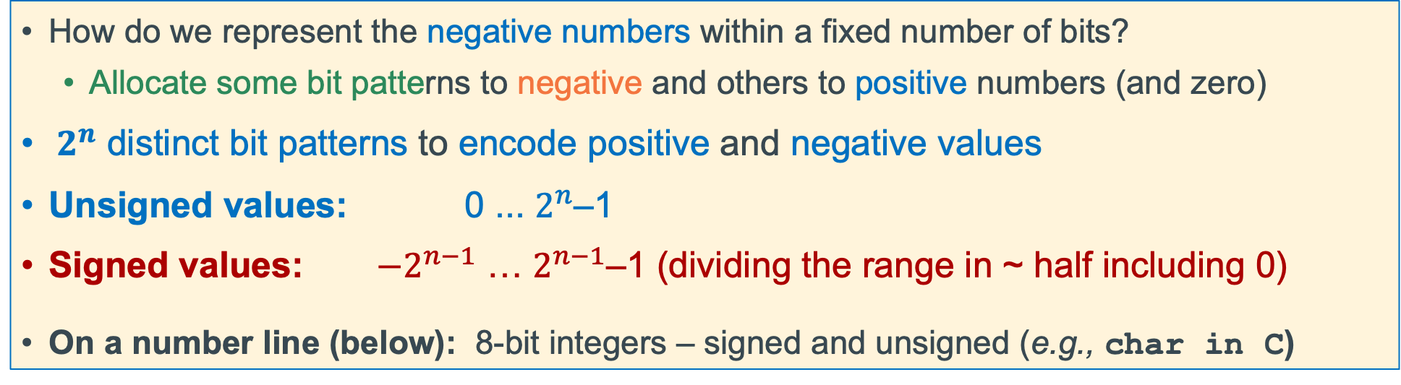
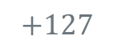
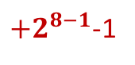
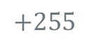

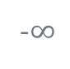
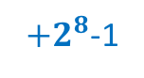
Problem: How to Encode Both Positive and Negative Integers
How do we represent the negative numbers within a fixed number of bits?
Allocate some bit patterns to negative and others to positive numbers (and zero)
$2^{n}$ distinct bit patterns to encode positive and negative values
Unsigned values: 0 ... $2^{n}$–1
Signed values: $−2^{n−1}$ … $2^{n−1}$–1 (dividing the range in ~ half including 0)
On a number line (below): 8-bit integers – signed and unsigned (e.g., char in C)
-1 comes from counting 0 as a "positive" number
$$0$$
Unsigned
$+2^{8}$-1
-$∞$
+$∞$
$$−128$$
$$0$$
$$+127$$
$$+255$$
$${−2}^{8−1}$$
$$0$$
Signed
${+2}^{8−1}$-1
Same “width” (same number of encodings), just shifted in value
x

Slide 10
Negative Integer Numbers: Sign + Magnitude Method
these numbers show bit position boundaries
31
30
0
Sign bit
Remaining bits
MSB
LSB
Use the Most Significant Bit as a sign bit
0 as the MSB represents positive numbers
1 as the MSB represents negative numbers
Two (oops) representations for zero: 0000, 1000
Tricky Math (must handle sign bit independently)
Positive and Negatives “increment” (+1) in the opposite directions!
x

Slide 11
Signed Magnitude Examples (Sign bit is always MSB)
Examples (4 bits):
0 110
0 0000000
1 000 = -0
1 001 = -1
1 010 = -2
1 011 = -3
1 100 = -4
1 101 = -5
1 110 = -6
1 111 = -7
0 000 = 0
0 001 = 1
0 010 = 2
0 011 = 3
0 100 = 4
0 101 = 5
0 110 = 6
0 111 = 7
positive
6
positive
0
1 011
1 0001100
negative
3
negative
12
x

Slide 12
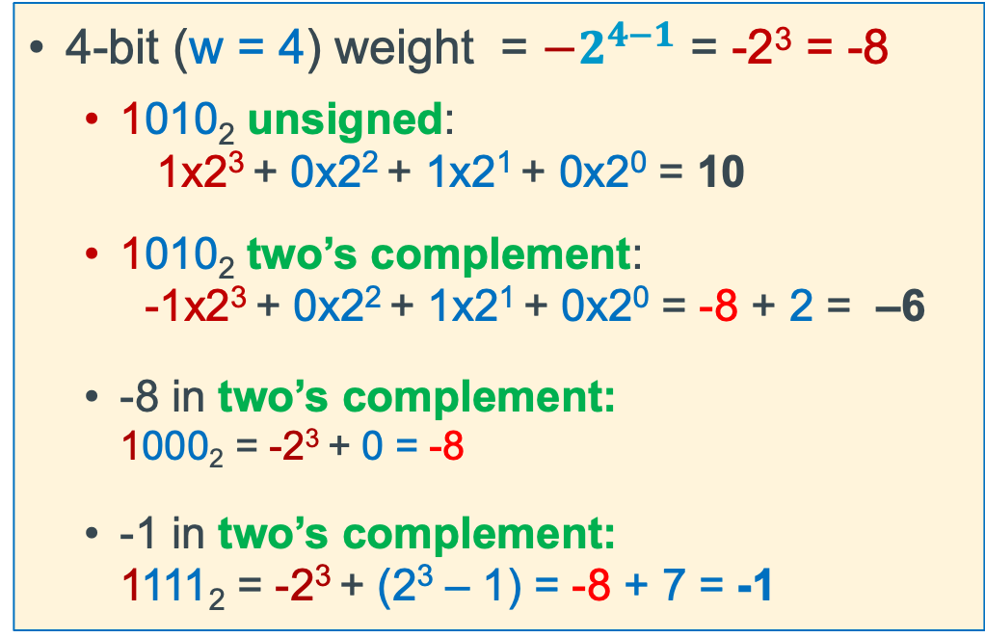
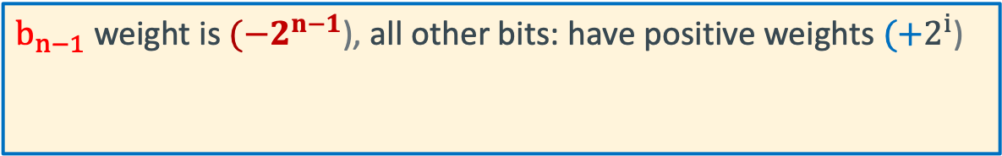
Two’s Complement: The MSB Has a Negative Weight
$$2^{′}s Comp={{−b}_{n−1}2}^{n−1}+ {b_{n−2}2}^{n−2}+ …+ {b_{1}2}^{1}+ b_{0}2^{0}$$
$b_{n−1}$ weight is $(−2^{n−1}$), all other bits: have positive weights $(+2^{i}$)
b_{n-1}
b_{n-2}
. . .
b₀
4-bit (w = 4) weight = $−2^{4−1}$ = -2³ = -8
1010₂ unsigned: 1x2³ + 0x2² + 1x2¹ + 0x2⁰ = 10
1010₂ two’s complement: -1x2³ + 0x2² + 1x2¹ + 0x2⁰ = -8 + 2 = –6
-8 in two’s complement: 1000₂ = -2³ + 0 = -8
-1 in two’s complement: 1111₂ = -2³ + (2³ – 1) = -8 + 7 = -1
x

Slide 13
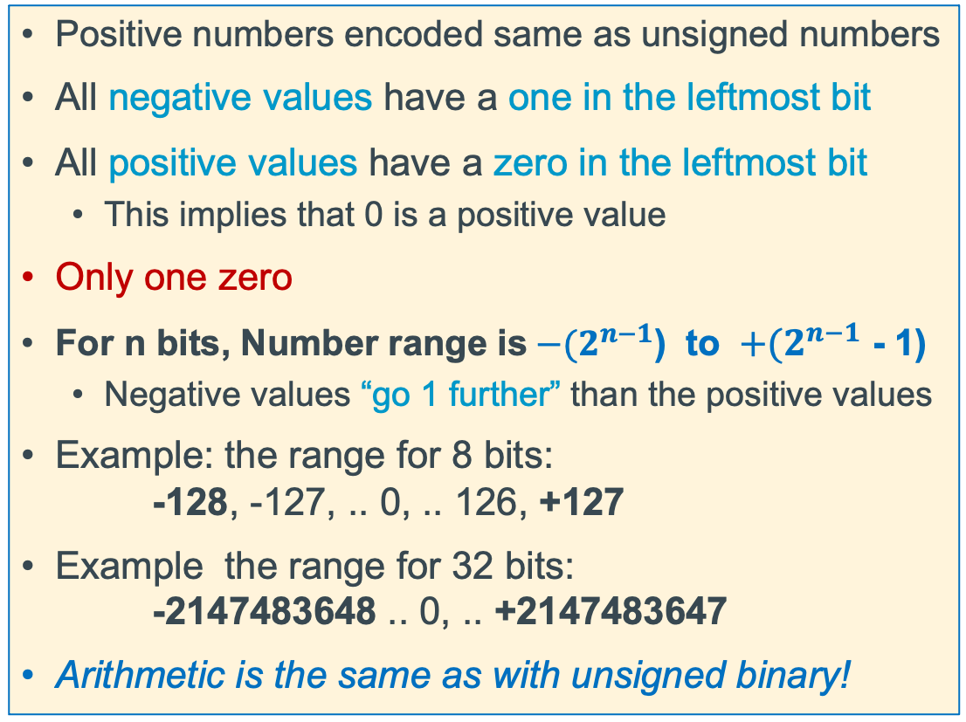
2's Complement Signed Integer Method
Positive numbers encoded same as unsigned numbers
All negative values have a one in the leftmost bit
All positive values have a zero in the leftmost bit
This implies that 0 is a positive value
Only one zero
For n bits, Number range is${ −(2}^{n−1}$) to ${ +(2}^{n−1}$ - 1)
Negative values “go 1 further” than the positive values
Example: the range for 8 bits: -128, -127, .. 0, .. 126, +127
Example the range for 32 bits: -2147483648 .. 0, .. +2147483647
Arithmetic is the same as with unsigned binary!
x

Slide 14
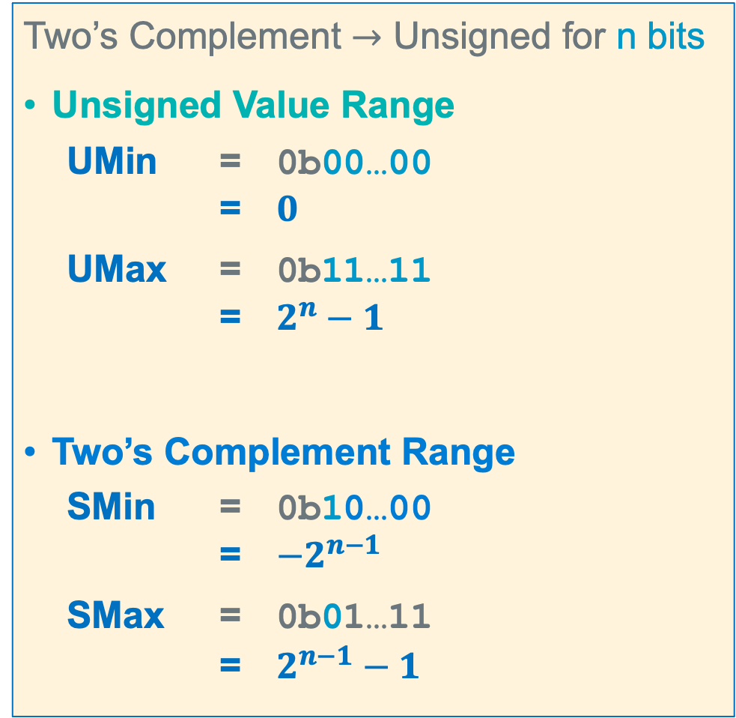
Summary: Min, Max Values: Unsigned and Two’s Complement
Two’s Complement $→$ Unsigned for n bits
Unsigned Value Range
UMin = 0b00…00 = $0$
UMax = 0b11…11 = $2^{n}−1$
Two’s Complement Range
SMin = 0b10…00 = $−2^{n−1}$
SMax = 0b01…11 = $2^{n−1}−1$
For n=4
x

Slide 15
Negation Of a Two’s Complement Number (Method 1)
7 = 0111
invert = 1000
add 1 + 1
-7 1001
-7 = 1001
invert = 0110
add 1 + 1
7 0111
-x == ~x + 1;
7 = 0111
-7 = + 1001
(discard carry) 0000
1 = 0001
invert = 1110
add 1 + 1
-1 1111
-1 = 1111
invert = 0000
add 1 + 1
1 0001
-8 = 1000
invert = 0111
add 1 + 1
-8 1000 oops!
x

Slide 16
Negation of a Two’s Complement Number (Method 2)
copy unchanged right most bit containing a 1 and all the 0's to its right
Invert all the bits to the left of the right-most 1
7 =
0 1 1
1
4 =
0
1 0 0
0 =
0 0 0 0
invert
Copy
invert
Copy
Copy
-7 =
1 0 0
1
-4 =
1
1 0 0
0 =
0 0 0 0
56 =
0 0 1 1
1 0 0 0
-8 =
1 0 0 0
invert
Copy
Copy
OOPS!
-56 =
1 1 0 0
1 0 0 0
-8 =
1 0 0 0
x

Slide 17
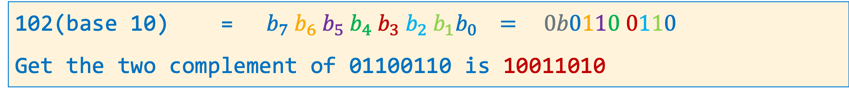
Signed Decimal to Two's Complement Conversion
dividend -102 | Quotient | Remainder | Bit Position
102/2 | 51 | 0 | b0
51/2 | 25 | 1 | b1
25/2 | 12 | 1 | b2
12/2 | 6 | 0 | b3
6/2 | 3 | 0 | b4
3/2 | 1 | 1 | b5
1/2 | 0 | 1 | b6
0/2 | 0 | 0 | b7
102(base 10) = ${ b}_{7}{ b}_{6}{ b}_{5}{ b}_{4}{ b}_{3}{ b}_{2}{{ b}_{1}b}_{0} = 0b0110 0110$
Get the two complement of 01100110 is 10011010
x

Slide 18
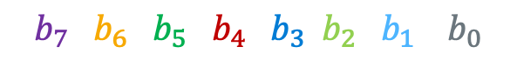
Two's Complement to Signed Decimal Conversion - Positive
What is 0 1 1 0 0 1 0 1(base 2) in decimal (N)?
$${ b}_{7}{ b}_{6}{ b}_{5}{ b}_{4}{ b}_{3}{ b}_{2}{{ b}_{1} b}_{0}$$
Signed Bit Bias | Bit | Bit Position | Bias
-2^{W-1} = -2⁸⁻¹ = -128 | x 0 | b7 | 0
Product Shift Left | Addend | Bit Position | Product
0 | + 1 | b6 | 1
2 x 1 = 2 | + 1 | b5 | 3
2 x 3 = 6 | + 0 | b4 | 6
2 x 6 = 12 | + 0 | b3 | 12
2 x 12 = 24 | + 1 | b2 | 25
2 x 25 = 50 | + 0 | b1 | 50
2 x 50 = 100 | + 1 | b0 | SUM = 101
 |  | Bias + SUM: | 0 + 101 = 101
x

Slide 19
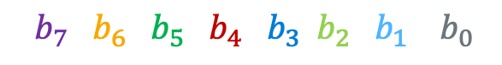
Two's Complement to Signed Decimal Conversion - Negative
What is 1 1 1 0 0 1 0 1(base 2) in decimal (N)?
$${ b}_{7}{ b}_{6}{ b}_{5}{ b}_{4}{ b}_{3}{ b}_{2}{{ b}_{1} b}_{0}$$
Signed Bit Bias | Bit | Bit Position | Bias
-2^{W-1} = -2⁸⁻¹ = -128 | x 1 | b7 | -128
Product Shift Left | Addend | Bit Position | Product
0 | + 1 | b6 | 1
2 x 1 = 2 | + 1 | b5 | 3
2 x 3 = 6 | + 0 | b4 | 6
2 x 6 = 12 | + 0 | b3 | 12
2 x 12 = 24 | + 1 | b2 | 25
2 x 25 = 50 | + 0 | b1 | 50
2 x 50 = 100 | + 1 | b0 | SUM = 101
 |  | Bias + SUM: | -128 + 101 = -27
x

Slide 20
Two’s Complement Addition and Subtraction
Addition: just add the two number directly
Subtraction: you can convert to addition: difference = minuend + 2’s complement (subtrahend)
x = 0 1 0 1 0 0 1 1
y = 0 0 0 0 1 0 1 1
Cout
0 0 0 0 0 0 1 1
x-y
x = 0 1 0 1 0 0 1 1
y = 0 0 0 0 1 0 1 1
`
x + y = 0 1 0 1 1 1 1 0
2’s complement first and then add
+ (-y) = 1 1 1 1 0 1 0 1
x = 0 1 0 1 0 0 1 1
x – y = x +(-y) = 0 1 0 0 1 0 0 0
x

Slide 21
Two’s Complement Positive Overflow
– 1
0
– 2
1111
0000
+ 1
– 3
1110
0001
+ 2
4-bit Two’s complement numbers (positive overflow)
1101
0010
– 4
+ 3
1100
Two’s Complement
0011
Cout
0
1
0
0
1011
0100
– 5
+ 4
0 1 0 1 5
+ 0 1 1 0 6
1010
0101
– 6
1001
0110
+ 5
1 0 1 1 -5 != 11
1000
0111
– 7
+ 6
– 8
+ 7
SMIN
SMAX
Overflow: Occurs when an arithmetic result is beyond the min or max limits
signed numbers: overflow occurs if
operands have same sign and result’s sign is different
x

Slide 22
Two’s Complement Negative Overflow
– 1
0
– 2
1111
0000
+ 1
– 3
1110
0001
+ 2
4-bit Two’s complement numbers (negative overflow)
1101
0010
– 4
+ 3
1100
Two’s Complement
0011
Cout
1
0
1
1
carry bit is dropped from result
– 5
1011
0100
+ 4
1 0 0 1 -7
+ 1 0 1 1 -5
1010
0101
– 6
1001
0110
+ 5
0 1 0 0 +4 != -12
– 7
1000
0111
+ 6
– 8
+ 7
SMIN
SMAX
signed numbers: overflow occurs if
operands have same sign and result’s sign is different
Overflow: Occurs when an arithmetic result is beyond the min or max limits
x

Slide 23
Summary: When Does Overflow Occur
Operand 1
+ Operand 2
Result
Operand 1 Sign | Operand 2 Sign | Is overflow Possible?
+ | + | YES
- | - | YES
+ | - | NO
- | + | NO
x

Slide 24
Sign Extension in C: Type casts
Convert from smaller to larger integral data types
C and Java automatically performs sign extension
Example (on pi-cluster with 32-bit int and 16-bit short)
#include <stdlib.h>
#include <stdio.h>
int main(void)
{
signed char c = -1;
signed int i = c;
unsigned char d = 1;
unsigned int j = d;
printf("c decimal = %hd\n", c);
printf("c = 0x%hhx\n", c);
printf("i decimal = %d\n", i);
printf("i = 0x%x\n", i);
printf("\nd decimal = %hd\n", d);
printf("d = 0x%hhx\n", d);
printf("j decimal = %d\n", j);
printf("j = 0x%x\n", j);
return EXIT_SUCCESS;
}
%./a.out
c decimal = -1
c = 0xff
i decimal = -1
i = 0xffffffff
d decimal = 1
d = 0x1
j decimal = 1
j = 0x1
x

Slide 25

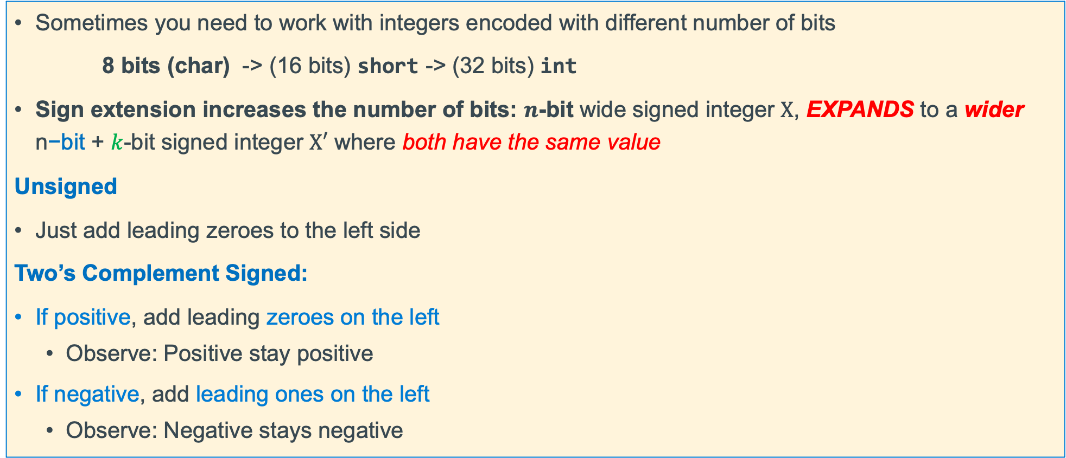
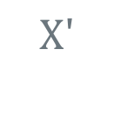

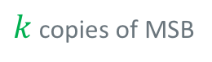
Sign Extension (how type promotion works)
Sometimes you need to work with integers encoded with different number of bits
8 bits (char) -> (16 bits) short -> (32 bits) int
Sign extension increases the number of bits: $n$-bit wide signed integer $X$, EXPANDS to a wider n$\text{−}\text{bit}$ + $k$-bit signed integer $X′$ where both have the same value
Unsigned
Just add leading zeroes to the left side
Two’s Complement Signed:
If positive, add leading zeroes on the left
Observe: Positive stay positive
If negative, add leading ones on the left
Observe: Negative stays negative
n$−bits$
$X$
• • •
• • •
$$Xʹ$$
• • •
• • •
$k$ copies of MSB
original $X \text{n}\text{−}\text{bits}$
x

Slide 26
Example: Two’s Complement Sign or bit Extension - 1
Adding 0's in front of a positive numbers does not change its value
7 = 0111
extend to
8 bits
00000111
Number is still 7
1 = 0001
extend to
8 bits
00000001
Number is still 1
x

Slide 27
Example: Two’s Complement Sign or bit Extension -2
Adding 1's if front of a negative number does not change its value
7 = 0111
invert = 1000
add 1 + 1
-7 1001
-7 = 1001
extend to
8 bits
11111001
1001 = -8 + 1 = -7
11111001 =
(-128 + 64 + 32 + 16 + 8) + 1 = -8 + 1 = -7
7 = 00000111
invert = 11111000
add 1 + 1
-7 11111001
x

Slide 28
Sign Extension Under Different representations
unsigned
0 | 0 | 0 | 0 | 0 | 0 | 0 | 0 | 1 | 1 | 0 | 1 | 0 | 1 | 1 | 0
0x00d6
zeroed | original bits
How to sign extend this bit pattern?
0xd6
move the sign bit
(replace original with a 0)
signed
magnitude
1 | 1 | 0 | 1 | 0 | 1 | 1 | 0
1 | 0 | 0 | 0 | 0 | 0 | 0 | 0 | 0 | 1 | 0 | 1 | 0 | 1 | 1 | 0
0x8056
s | zeroed | magnitude
extend the sign bit
two’s
complement
1 | 1 | 1 | 1 | 1 | 1 | 1 | 1 | 1 | 1 | 0 | 1 | 0 | 1 | 1 | 0
0xffd6
sign extension | original bits
x

Slide 29
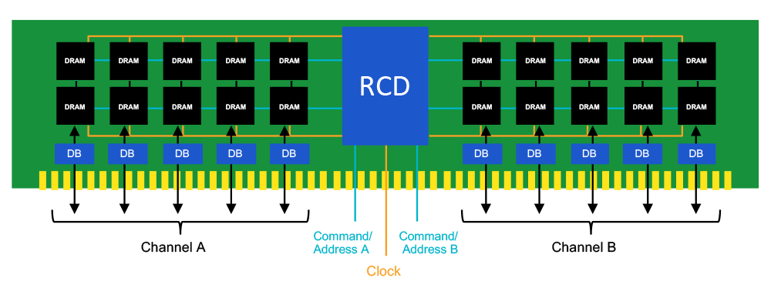
Memory Size
Since memory addresses are implemented in hardware using binary
The Size (number of byte sized cells) of Memory is specified in powers of 2
Memory size/capacity in bytes is specified by the “Number of bits" in an address
32 bits of address = 2³² ⁼ 4,294,967,296
Address Range is 0 to 2³² – 1 (unsigned)
Shorthand notation for address size (Memory Capacity)
KB = 2¹⁰ (K=1024) kilobyte
MB = 2²⁰ megabyte
GB = 2³⁰ gigabyte
TB = 2⁴⁰ terabyte
PB = 2⁵⁰ petabyte
Memory dimm
Address Bits
Data Bits
Data Bits
x

Slide 30
Different Type of Numbers each have a Fixed # of Bits Spanning one or more contiguous bytes of memory
C Data Type | AArch-32 contiguous Bytes
char (arm unsigned) | 1
short int | 2
unsigned short int | 2
int | 4
unsigned int | 4
long int | 4
long long int | 8
float | 4
double | 8
long double | 8
pointer * | 4
Byte 8-bit integer uses 1 byte
00000000
7
0
Half Word 16-bit integer uses 2 bytes
000000001
00000000
15
7
0
most significant bit (largest power of 2)
least significant byte
Word 32-bit integer uses 4 bytes
00000011
00000010
00000001
00000000
31
0
least significant bit (smallest power of 2)
most significant byte
x

Slide 31
Byte Ordering of Numbers In Memory: Endianness
Two different ways to place multi-byte integers in a byte addressable memory
Big-endian: Most Significant Byte (“big end”) starts at the lowest (starting) address
Little-endian: Least Significant Byte (“little end”) starts at the lowest (starting) address
Example: 32-bit integer with 4-byte data
Little-Endian
Big-Endian
a1
b2
c3
d4
23
0x103
23
0x103
d4
a1
01
0x102
01
0x102
c3
MSB
Most significant byte
LSB
Least significant byte
b2
c3
0x101
b2
0x101
d4
0x100
a1
0x100
x

Slide 32
Byte Ordering Example
Decimal: 12345
Binary: 0011 0000 0011 1001
Hex: 3 0 3 9
int x = 12345;
// or x = 0x00003039; // show all 32 bits
(big-endian)
IA32, ARM32 (little-endian)
0x03
39
00
0x03
0x02
30
00
0x02
0x01
00
30
0x01
0x00
00
39
0x00
x

Slide 33
Byte Addressable Memory Shown as 32-bit words
1 byte Memory Content
One byte per row
Contents of Memory
One 32-bit (4 byte) word per row
Byte
Memory
Address
Word
Memory
Address
0x07
0x12345687
MSByte
LSByte
0x06
0x12345686
1 32-bit
(4 byte) word
0x12345694
0x05
0x12345685
Word Aligned address
0x04
0x12345684
0x12345690
0x12345683
0x1234568C
0x03
0x12345688
0x02
0x12345682
1 32-bit
(4 byte) word
0x07
0x06
0x05
0x04
0x12345684
0x01
0x12345681
Word Aligned address
0x12345680
0x03
0x02
0x01
0x00
0x12345680
0x00
0x12345683
0x12345682
0x12345681
0x12345680
Byte address
Observation
32-bit aligned addresses
rightmost 2 bits of the address are always 0
x

Slide 34
Do we want to do floating point?

Slide 35
Scientific Notation Binary
mantissa
exponent
+1.01₂ × 2⁻¹
sign
binary point
radix (base)
Computer hardware that supports this is called floating point hardware due to the “floating” of the binary point
Declare such variable in C as float (or double)
x

Slide 36
Floating Point Representation
Analogous to scientific notation
In Decimal:
Not 12000000, but 1.2 x 10⁷ In C: 1.2e7
Not 0.0000012, but 1.2 x 10⁻⁶ In C: 1.2e-6
In Binary:
Not 11000.000, but 1.1 x 2⁴
Not 0.000101, but 1.01 x 2⁻⁴
x

Slide 37
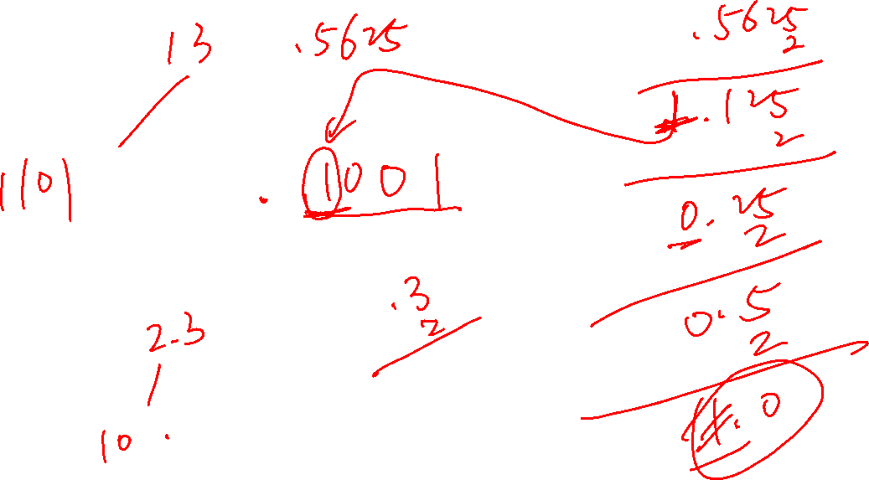

Slide 38
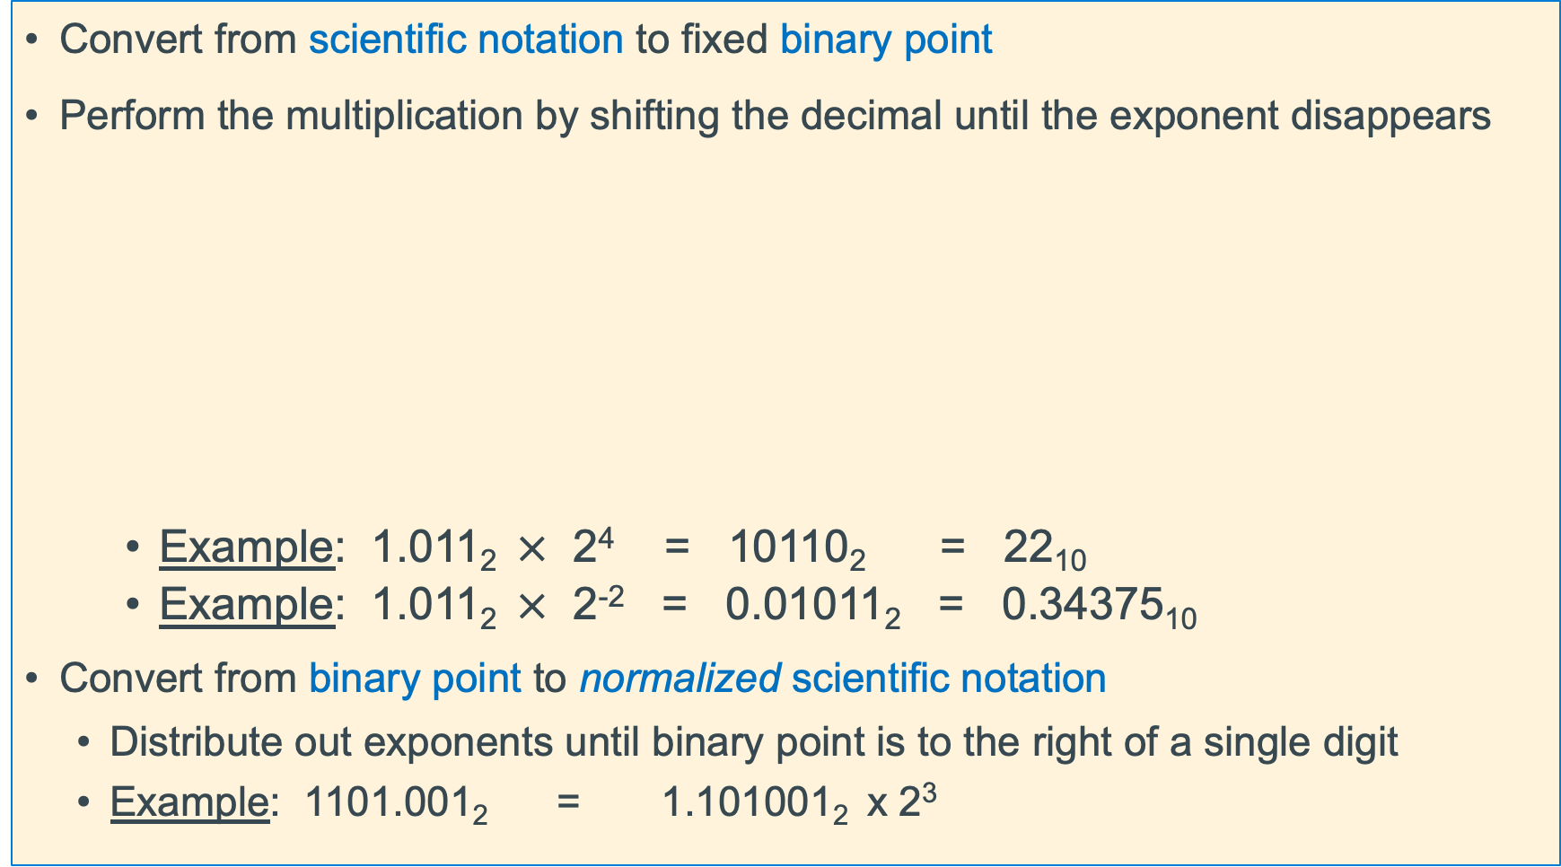
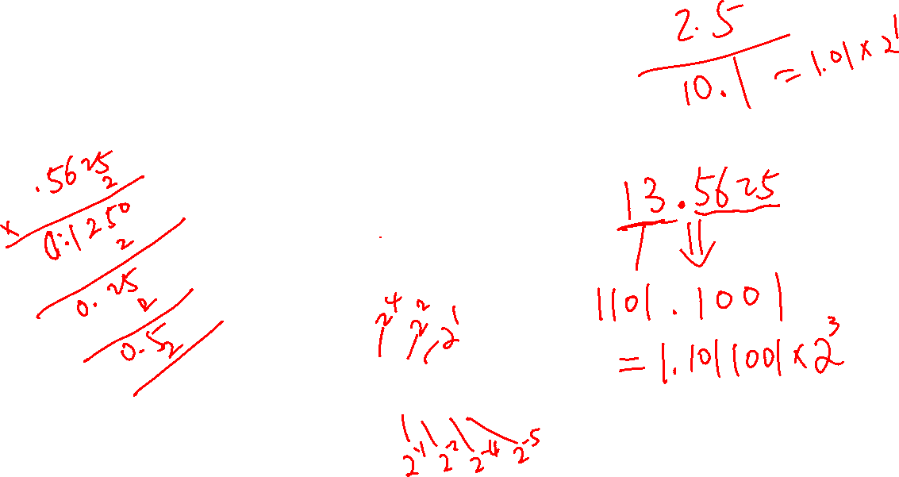
Normalized Scientific Notation
Convert from scientific notation to fixed binary point
Perform the multiplication by shifting the decimal until the exponent disappears
Example: 1.011₂$×$ 2⁴ = 10110₂ = 22₁₀
Example: 1.011₂$×$ 2⁻² = 0.01011₂ = 0.34375₁₀
Convert from binary point to normalized scientific notation
Distribute out exponents until binary point is to the right of a single digit
Example: 1101.001₂ = 1.101001₂ x 2³
Binary | Decimal
2⁻¹ | 0.5
2⁻² | 0.25
2⁻³ | 0.125
2⁻⁴ | 0.0625
x

Slide 39
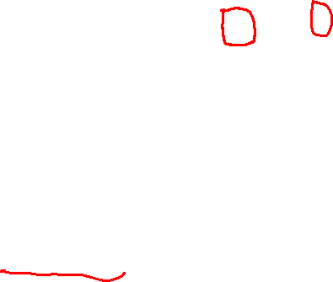
Encoding Fractions Observations
In Base 2:
10.1 x 2⁵ = 1.01 x 2⁶
1011.1 x 2⁵ = 1.0111 x 2⁸
0.110 x 2⁵ = 1.10 x 2⁴
Normalizing with base 2 :
adjust so there always a 1 to the left of the decimal point!
this 1 is called the hidden bit as we do not have use a bit to store it since it is there in every normalized mantissa
Adjust x to always be in the format 1.XXXXXXXXX… (fraction is normalized)
Fraction portion ONLY encodes what is to the right of the decimal point
“Hidden bit” allows number to have One additional digit for increased precision
Fraction encoding is 1.[FRACTION BINARY DIGITS]
x

Slide 40
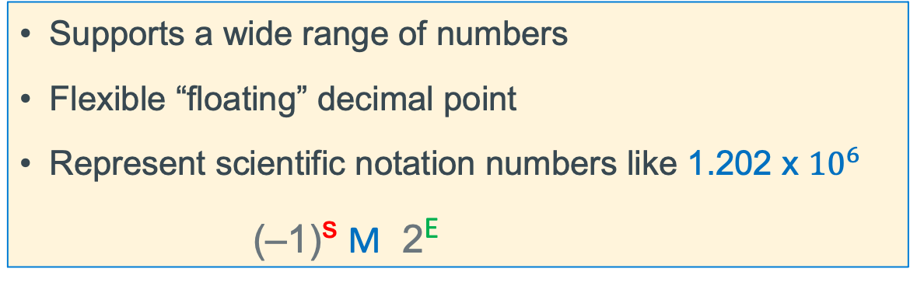

Floating Point Numbers: Implementation Approach
Supports a wide range of numbers
Flexible “floating” decimal point
Represent scientific notation numbers like 1.202 x ${10}^{6}$
(–1)^{s} M 2E
S
E
M
sign bit
exponent
fraction
Sign bit (a single bit): 0 positive, 1 negative
Exponent: encoding of E above (it is NOT E directly represented in binary)
Fraction: encoding of M above (it is NOT M directly represented in binary)
x

Slide 41
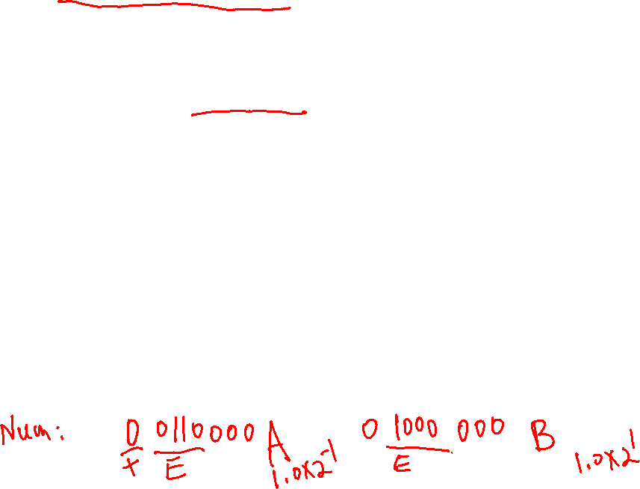
Excess Bias Encoding (As used in floating point numbers)
Given a number in E bits, to divide the range in about 1/2 the following is used:
excess N bias = (2^{E-1} – 1) (this is just one of many bias formulas)
With this excess N Bias approach: actual numbers range from most negative to most positive is: -(bias) to bias+1
So, for a number that is limited to 4 bits (0 to 15 unsigned)
Then excess N bias = 2⁴⁻¹ - 1 = 2³ - 1 = a bias of +7
actual | -7 | -6 | -5 | -4 | -3 | -2 | -1 | 0 | 1 | 2 | 3 | 4 | 5 | 6 | 7 | 8
bias | +7 | +7 | +7 | +7 | +7 | +7 | +7 | +7 | +7 | +7 | +7 | +7 | +7 | +7 | +7 | +7
bias encoded | 0 | 1 | 2 | 3 | 4 | 5 | 6 | 7 | 8 | 9 | 10 | 11 | 12 | 13 | 14 | 15
x

Slide 42
Floating Point Number in a Byte (Not A Real Format)
S = 1 bit
7
6
E = 3 bits
4
3
M = 4 bits
0
sign bit
exponent
fraction
1 byte = 8 bits total
Mantissa encoding: = 1.[xxxx] encoded as an unsigned value
Exponent encoding: 3 bits encoded as an unsigned value using bias encoding
Bias encoding = (2^{E-1} – 1)
3 bits for the bias we have 2³⁻¹ - 1 = 2² - 1 = a bias of 3
With a Bias of 3: positive and negative numbers range: small to large is: 2⁻³ to 2⁴
Actual | -3 | -2 | -1 | 0 | 1 | 2 | 3 | 4
Bias | + 3 | + 3 | + 3 | + 3 | + 3 | + 3 | + 3 | +3
Biased | 0 | 1 | 2 | 3 | 4 | 5 | 6 | 7
x

Slide 43
Scientific Notation Decimal
mantissa
exponent
+6.02₁₀ × 10²³
sign
decimal point
radix (base)
Scientific Normalized form:
exactly one digit (non-zero) to left of decimal point
Alternatives to representing 1/1,000,000,000
Normalized: 1.0×10⁻⁹
Not normalized: 0.1×10⁻⁸, 10.0×10⁻¹⁰
x

Slide 44
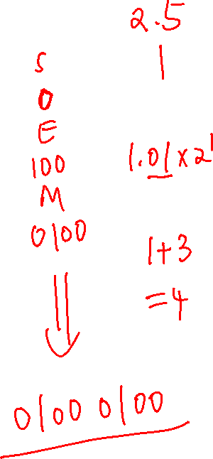
Floating Point Number in a Byte (Not A Real Format)
S = 1 bit
7
6
E = 3 bits
4
3
M = 4 bits
0
sign bit
exponent
fraction
1 byte = 8 bits total
Mantissa encoding: = 1.[xxxx] encoded as an unsigned value
Exponent encoding: 3 bits encoded as an unsigned value using bias encoding
Bias encoding = (2^{E-1} – 1)
3 bits for the bias we have 2³⁻¹ - 1 = 2² - 1 = a bias of 3
With a Bias of 3: positive and negative numbers range: small to large is: 2⁻³ to 2⁴
Actual | -3 | -2 | -1 | 0 | 1 | 2 | 3 | 4
Bias | + 3 | + 3 | + 3 | + 3 | + 3 | + 3 | + 3 | +3
Biased | 0 | 1 | 2 | 3 | 4 | 5 | 6 | 7
x

Slide 45
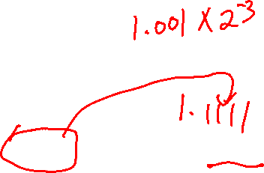
Floating Point Number (8-bits) Number Range: 2⁻³ to 2⁴
S = 1 bit
E = 3 bits
M = 4 bits
sign bit
exponent
fraction
S = 1 bit
E = 3 bits
M = 4 bits
0
000
0000
0.0 Special case in this simple model
we do not put back the “hidden bit”
S = 1 bit
E = 3 bits
M = 4 bits
Smallest Non-zero Positive
0.0010001 = 1/8 + 1/128 = 0.1328125 base 10
0
000
0001
S = 1 bit
E = 3 bits
M = 4 bits
Largest Positive/Negative
1.1111 x 2⁴ = 11111 = 31 base 10
0/1
111
1111
S = 1 bit
E = 3 bits
M = 4 bits
Smallest (closest to zero) Number
1.0000 x 2⁻³ = 0.001000 = 1/8 = -0.125 base 10
1
000
0000
Note: Orange is hidden bit added back
x

Slide 46
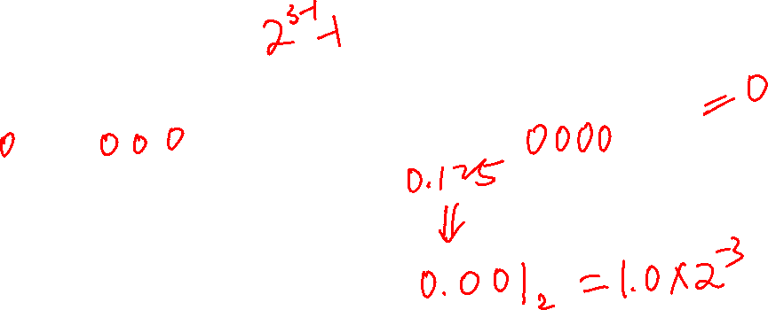
Decimal to Float
7 | 6 |  |  |  | 4 | 3 |  |  |  |  | 0
s | exponent (3 bits) |  |  |  |  | fraction (4 bits)
Bias of 3
Step 1: convert from base 10 to binary (absolute value)
-0.375(decimal) = 0000.01102
Step 2: Find out how many places to shift to get the number into the normalized 1.xxxx mantissa format
0000.01102 = 1.1000 x (2⁻²)base 10
exponent: -210 + bias of 310 = 110 = 0b001 for the exponent (after adding the bias)
Step 3: Use as many digits that fit to the right of the decimal point in the fractional .xxxx part 1.1000
Step 4: Sign bit
positive sign bit is 0
negative sign bit is 1
s | exponent | fraction
1 | 0b001 | 0b1000
0x9 |  | 0x8
= 0x98
x

Slide 47
Float to Decimal
7 | 6 |  |  |  | 4 | 3 |  |  |  |  | 0
s | exponent (3 bits) |  |  |  |  | fraction (4 bits)
Bias of 3
Step 1: Break into binary fields
0x45 =
Step 2: Extract the unbiased exponent
0b100 = 4base 10 - bias of 310 = 110 for the exponent (bias removed)
Step 3: Express the mantissa (restore the hidden bit)
1.0101
Step 4: Apply the unbiased exponent
1.0101base 2 x (2¹)base 10 = 10.101
Step 5: Convert to decimal
10.101 = 2.625base 10
Step 6: Apply the Sign
+ 2.625base 10
0x4 |  | 0x5
s | exponent | fraction
0 | 0b100 | 0b0101
x

Slide 48

IEEE “754” Floating Point Double and Single Precision
31 | 30 |  | 23 | 22 |  |  |  |  | 0
sign | Exponent (8 bits) Uses a Bias of 127 |  |  | fraction (23 bits)
Single Precision (C float)
$$Bias is{ (2}^{8−1 }−) =127$$
$single precision floating point number={(−1)}^{s }{x 2}^{E−127 }$x 1.fraction
63 | 62 |  | 52 | 51 |  |  |  |  | 0
sign | Exponent (11 bits) Uses a Bias of 1023 |  |  | fraction (52 bits)
Double Precision (C Double)
$$bias is{ (2}^{11−1 }−1) =1023$$
$double precision floating point number={(−1)}^{s }{x 2}^{E−1023 }$x 1.fraction
x

Slide 49

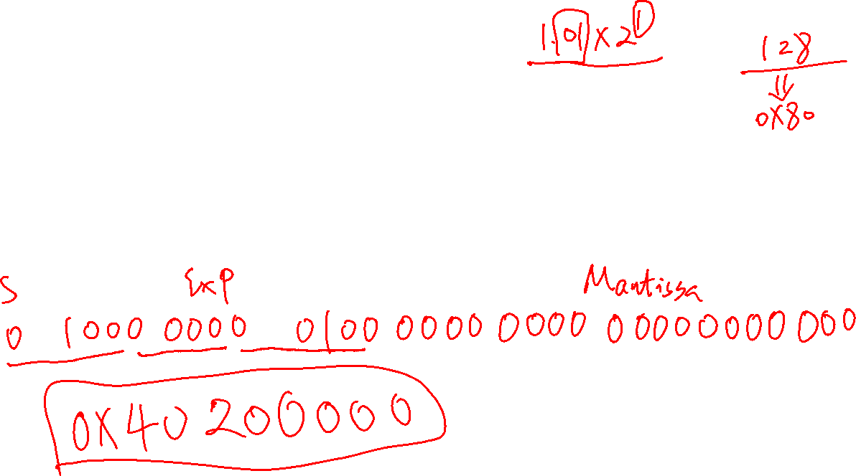
Convert 2.5 to IEEE754 format
31 | 30 |  | 23 | 22 |  |  |  |  | 0
sign | Exponent (8 bits) Uses a Bias of 127 |  |  | fraction (23 bits)
Single Precision (C float)
$$Bias is{ (2}^{8−1 }−) =127$$
$single precision floating point number={(−1)}^{s }{x 2}^{E−127 }$x 1.fraction
x

Slide 50
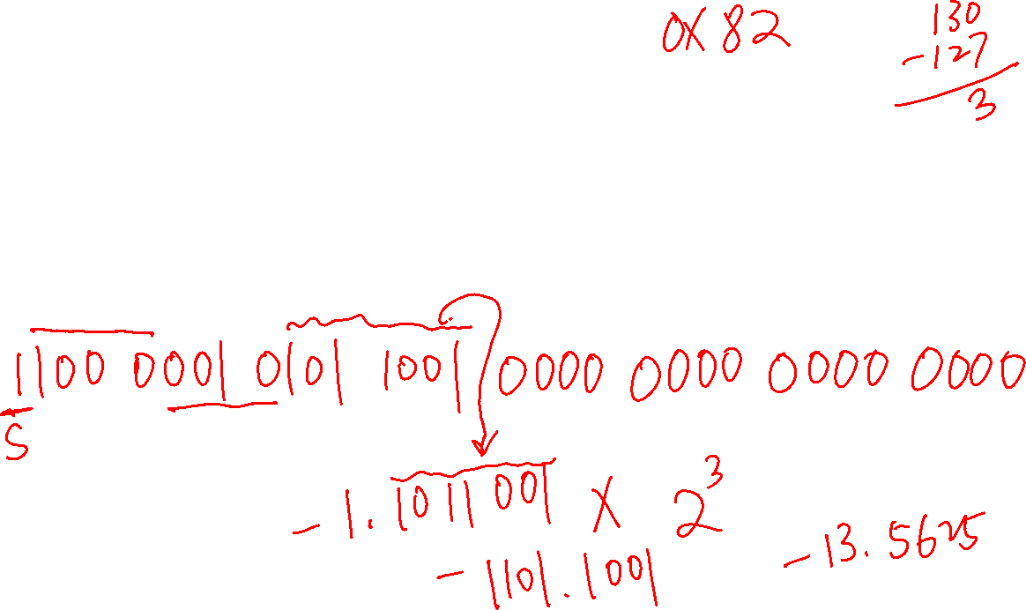
What is the equivalent of 0xC1590000
31 | 30 |  | 23 | 22 |  |  |  |  | 0
sign | Exponent (8 bits) Uses a Bias of 127 |  |  | fraction (23 bits)
Single Precision (C float)
$$Bias is{ (2}^{8−1 }−) =127$$
$single precision floating point number={(−1)}^{s }{x 2}^{E−127 }$x 1.fraction
x

Slide 51
Extra slides

Slide 52
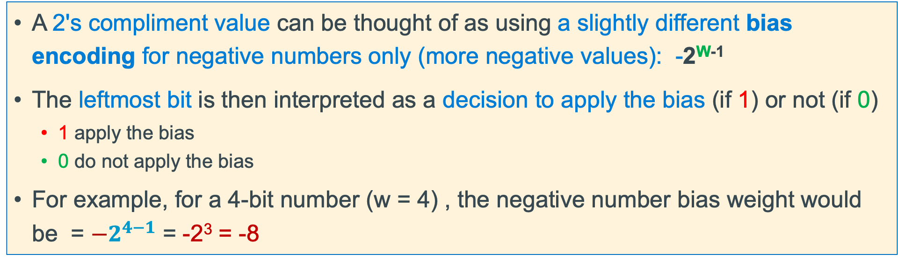
Another Way to Look at 2's Complement Encoding
A 2's compliment value can be thought of as using a slightly different bias encoding for negative numbers only (more negative values): -2^{W-1}
The leftmost bit is then interpreted as a decision to apply the bias (if 1) or not (if 0)
1 apply the bias
0 do not apply the bias
For example, for a 4-bit number (w = 4) , the negative number bias weight would be = $−2^{4−1}$ = -2³ = -8
2's | 1000 | 1001 | 1010 | 1011 | 1100 | 1101 | 1110 | 1111 | 0000 | 0001 | 0010 | 0011 | 0100 | 0101 | 0110 | 0111
3 bit | 000 | 001 | 010 | 011 | 100 | 101 | 110 | 111 | 000 | 001 | 010 | 011 | 100 | 101 | 110 | 111
decimal | 0 | 1 | 2 | 3 | 4 | 5 | 6 | 7 | 0 | 1 | 2 | 3 | 4 | 5 | 6 | 7
+Bias | -8 | -8 | -8 | -8 | -8 | -8 | -8 | -8 | 0 | 0 | 0 | 0 | 0 | 0 | 0 | 0
Actual | -8 | -7 | -6 | -5 | -4 | -3 | -2 | -1 | 0 | 1 | 2 | 3 | 4 | 5 | 6 | 7
Observe: adding +1 makes the number more positive for both negative and positive numbers
x

Slide 53
Decimal to IEEE Single Precision Float
31 | 30 |  | 23 | 22 |  |  |  |  | 0
sign | Exponent (8 bits) Bias is 127 |  |  | fraction (23 bits)
Step 1: convert from base 10 to binary (absolute value)
-13.375(decimal) = 1101.0110
Step 2: Find out how many places to shift to get the number into the normalized 1.xxxx mantissa format
1101.0110 = 1.1010110 x (2³)base 10
3 + bias of 127 = 130 for the exponent = 0b1000 0010
Step 3: Use as many digits that fit to the right of the decimal point in the fractional .xxxx part (0 pad )
1.1010110 0000 0000 0000 0000
Step 4: If the sign is positive sign bit is 0, otherwise it is 1
s | exponent | fraction
1 | 100 0001 0 | 101 0110 0000 0000 0000 0000
0xc
0x1
0x5
0x6
0x0
0x0
0x0
0x0
= 0xc1560000
x

Slide 54
IEEE Single Precision Float to Decimal
31 | 30 |  | 23 | 22 |  |  |  |  | 0
sign | Exponent (8 bits) Bias is 12710 |  |  | fraction (23 bits)
Step 1: Break into binary fields and expand as needed
0xc0b00000 =
Step 2: Find the exponent
0b10000001 = 129base 10 - bias of 12710 = 210 exponent with bias added
Step 3: Express the mantissa (restore the hidden bit)
1.0110
Step 4: Apply the exponent
1.0110 x (2²)base 10 = 101.10
Step 5: Convert to decimal
101.10 = 5.5
Step 6: Apply the Sign
-5.5
0xc
0x0
0xb
0x0
0x0
0x0
0x0
0x0
1 | 100 0000 1 | 011 0000 0000 0000 0000 0000
x

